Slide 1
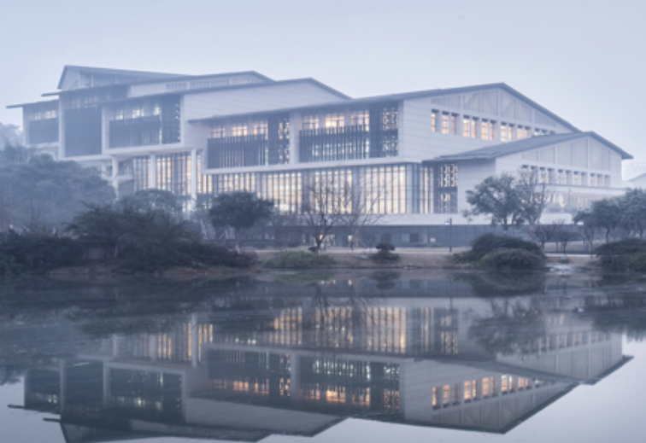
Chongqing University of Technology
ATAI
Advanced Technique of Artificial Intelligence
Chongqing University of Technology
AAAI_2021
https://github.com/modriczhang/HRL-Rec
Hongyang Song

Slide 2
Outline
Motivation
Approach
Experiments
Conclusion

Slide 3
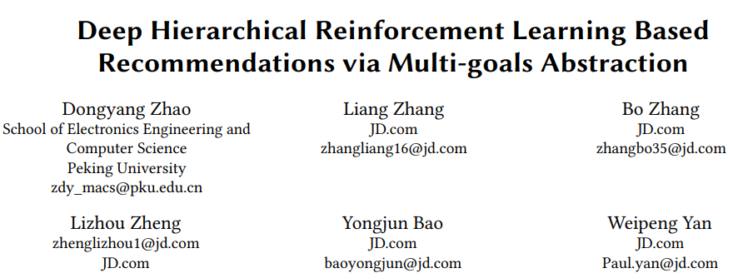
Motivation
KDD_2019
SIGIR_2020

Slide 4
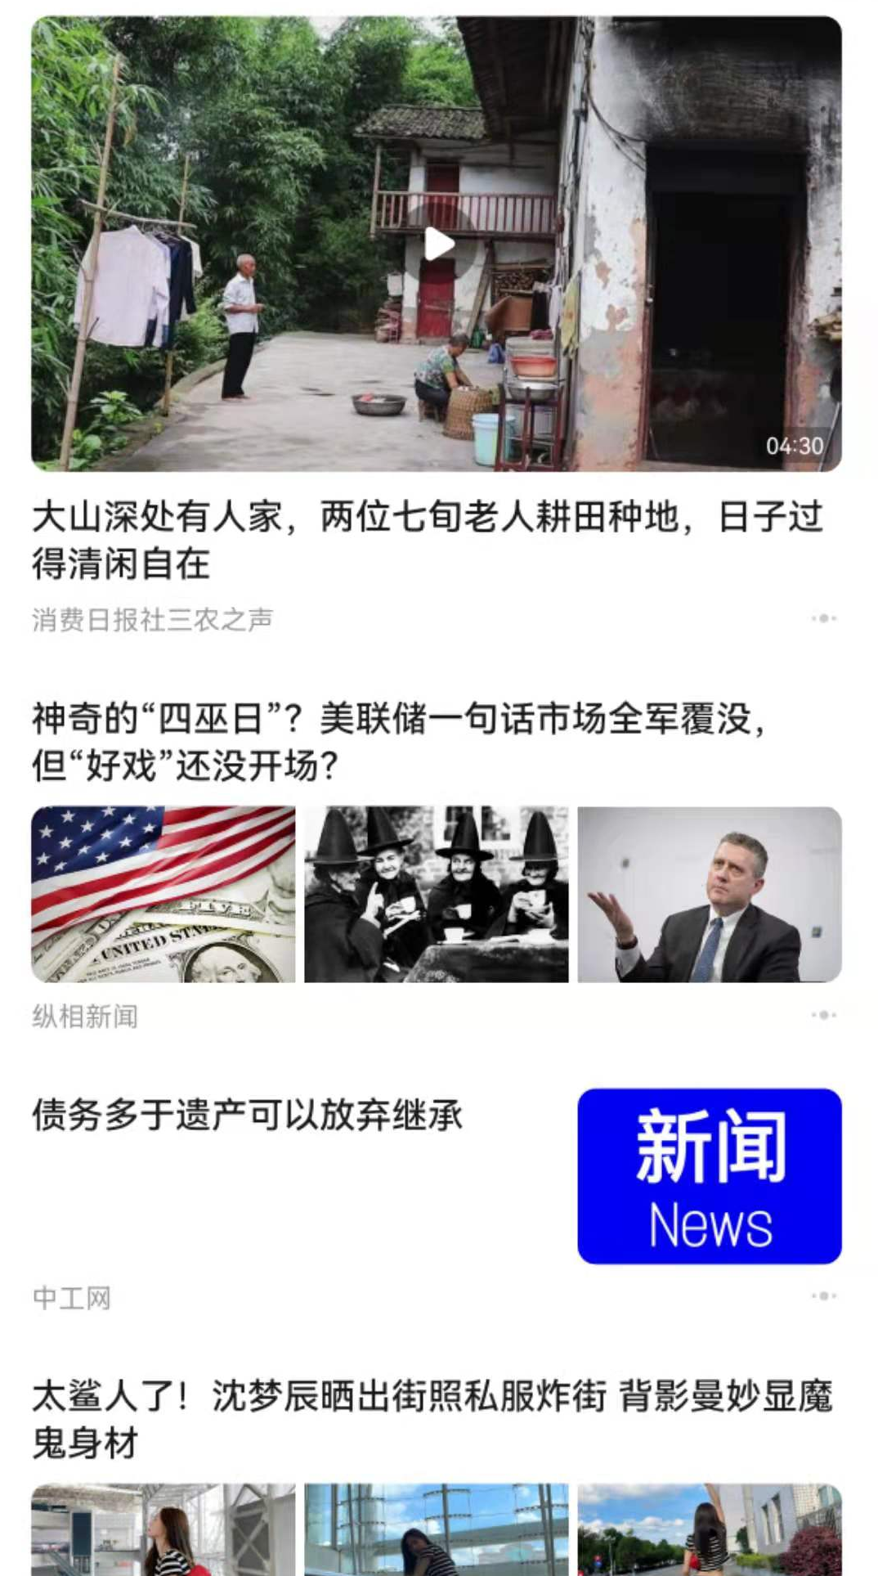
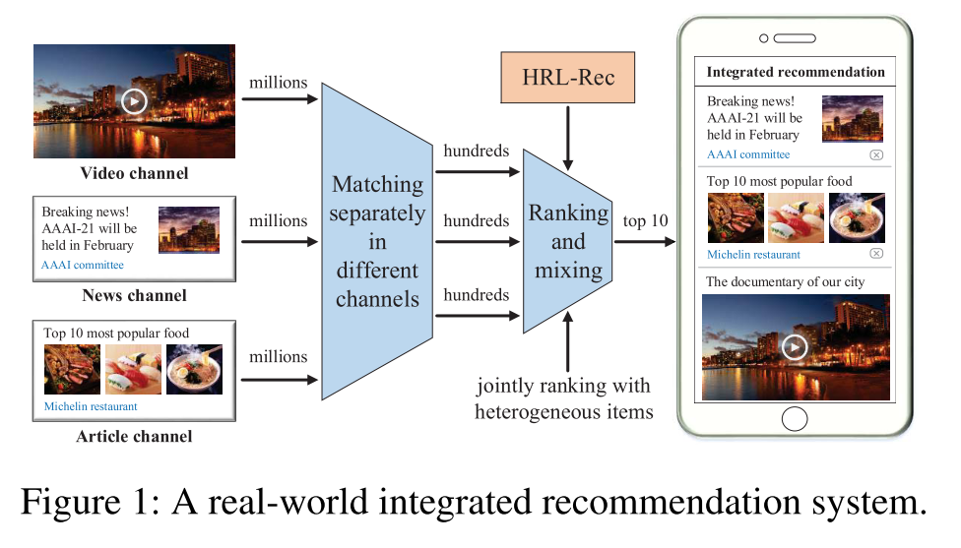
Motivation
Integrated recommendation
Notes:
1. 来自多渠道的异构物品通常具有不同的特性和排名策略。要比较不同渠道的项目来进行联合排名是极其困难的。
2. 用户在项目和渠道级别上都有个性化的偏好。通道上的粗粒度用户偏好对推荐也有重要影响
3. 现实世界的综合推荐高度重视在线模型的稳定性

Slide 5
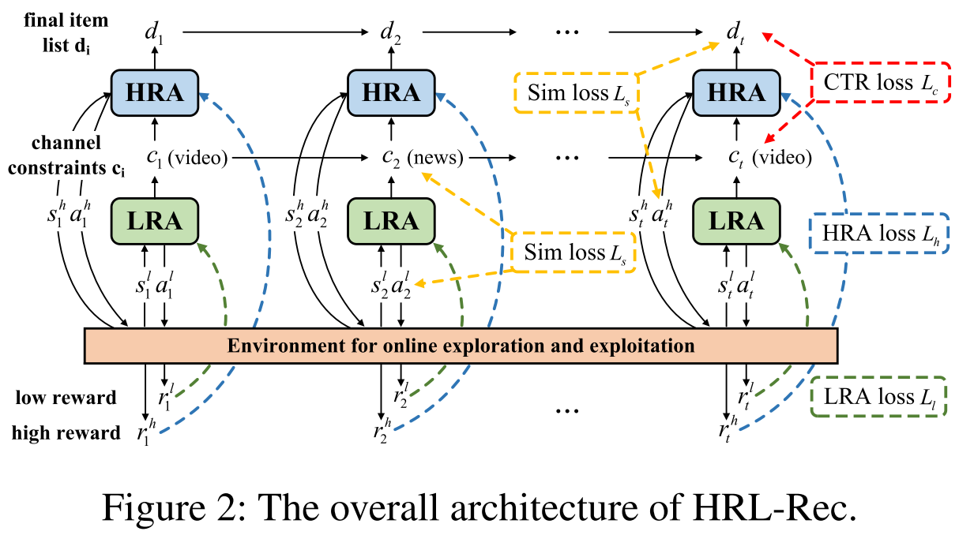
Approach
LRA: low-level RL agent
channel selector
Low-level state $s^{l}$:
user profiles
user historical behaviors
recommendation contexts
recent channels impressions
Low-level action $a^{l}$:
generating a channel
Low-level reward $r^{l}$:
measured by the click times
Notes:
recent channels impressions: 展示给用户的渠道 impression indicates the item/channel is exposed/shown to a user

Slide 7
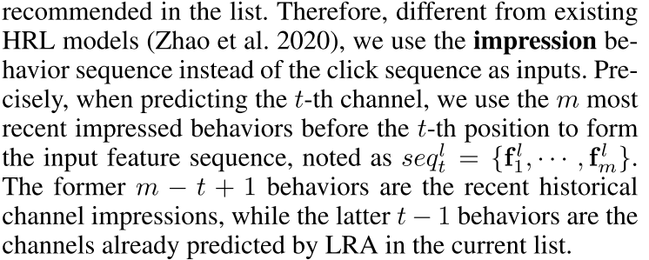
Approach
${\hat{F}}_{i}^{l}$:
user long-term profiles
recommendation contexts
current channel features
cumulative channel features
Notes:
recent channels impressions: 展示给用户的渠道 impression indicates the item/channel is exposed/shown to a user

Slide 8
Approach
HRA: high-level RL agent
item recommender
High-level state $s^{h}$:
user profiles
user historical behaviors
recommendation contexts
recently item impression
channel constraints
High-level action $a^{h}$:
generating an item
High-level reward $r^{h}$:
item click times
dwell time
list-level diversity and item novelty
diversity and novelty in item level

Slide 9
Approach
${\hat{F}}_{i}^{h}$:
user long-term profiles
recommendation contexts
current item features
cumulative item features
channel constraints

Slide 10
Approach

Slide 11
Approach

Slide 12
Experiments

Slide 13
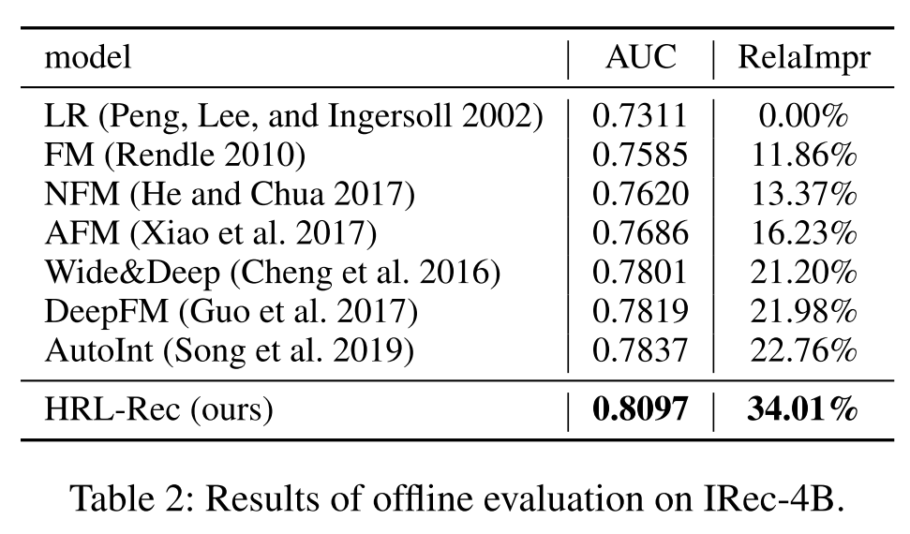
Experiments
Offline Evaluation
Area Under Curve(AUC)
RelaImpr
ICML_2014_Coupled group lasso for web-scale ctr prediction in display advertising

Slide 14
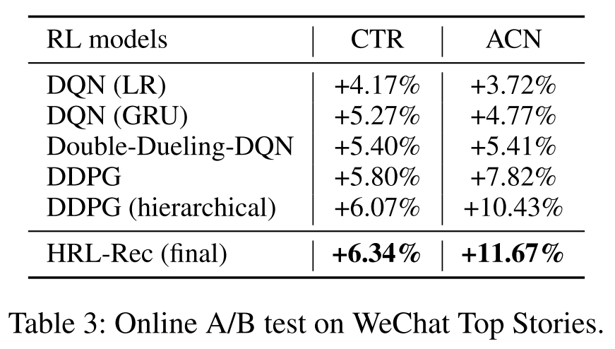
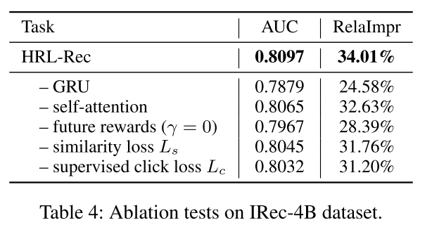
Experiments
Online A/B Tests
Ablation Tests

Slide 15
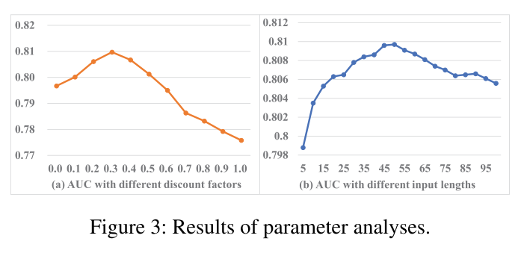
Experiments
Analysis on Discount Factor γ
Analysis on Input Sequence Length

Slide 16
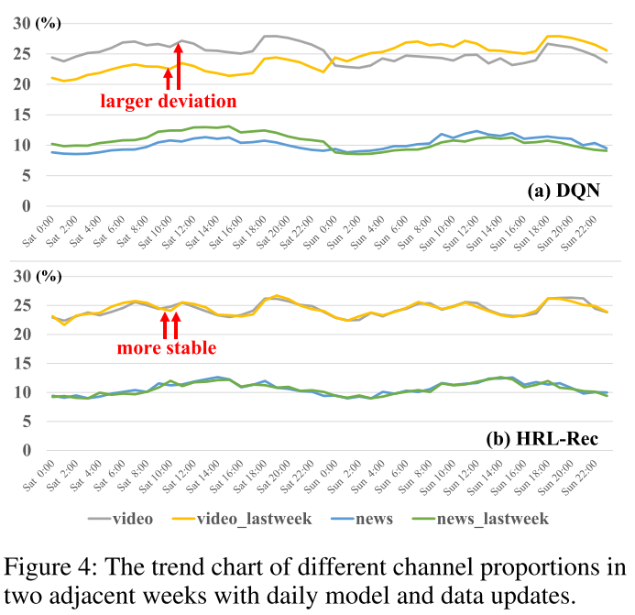
Experiments
Online Model Stability

Slide 17
Thanks

